Slide 1
Q2 TII Daniel 02/10/2024

Slide 2
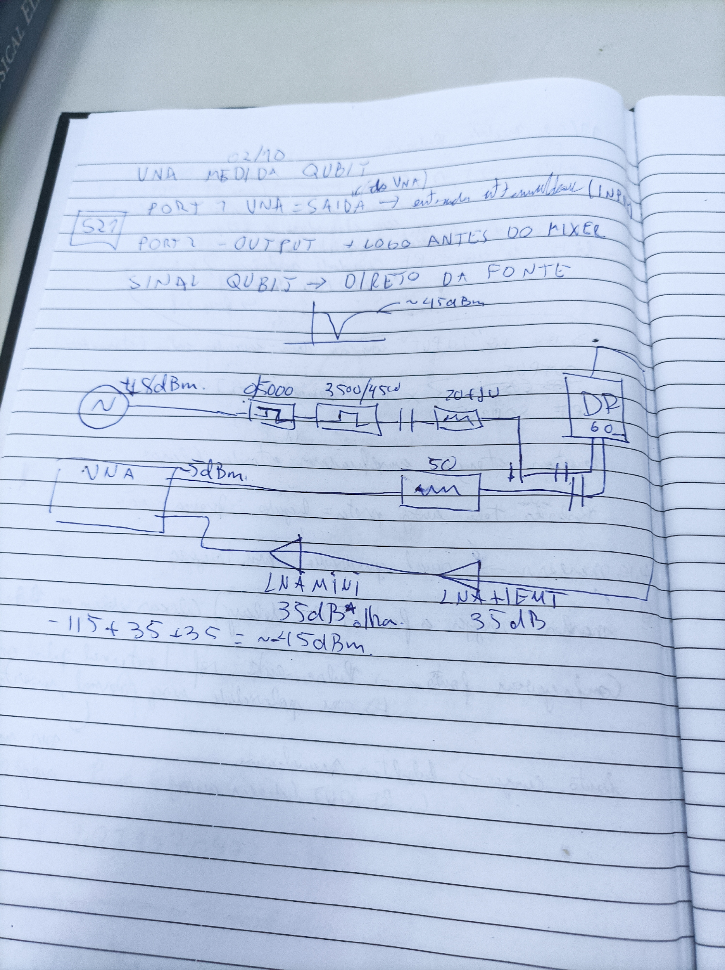
Medida com VNA

Slide 3
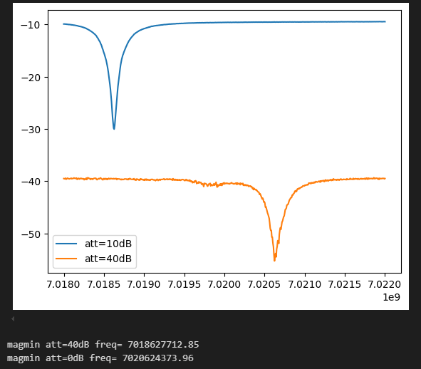

Slide 4
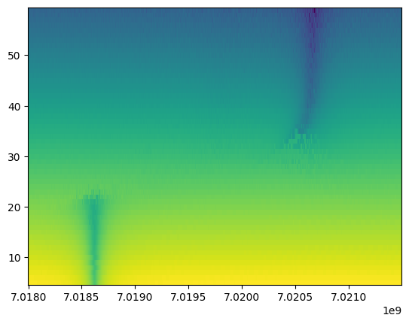
Power sweep
PowerSweep_Q2TII__2024_10_02__15_14_28

Slide 5
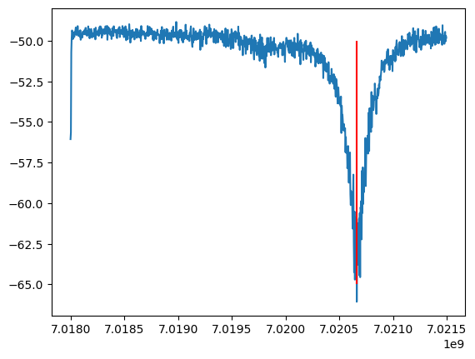
Slice do power sweep anterior em 50dB fmin= 7.0206635 GHz

Slide 6
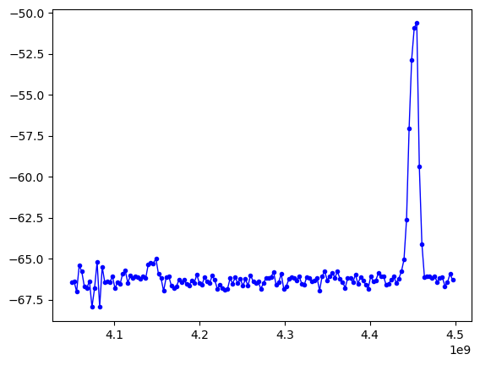
SWEEP Two tone
Vna -5dBm
inst_att.set_attenuation(50)
inst_RFsourceExcitation.set_amplitude(18)
Freq = np.arange(4400, 4500, 3) * 1e6
Filtro DC-5000, filtro 3500-4500, DC block, att10dB, att20dB

Slide 7
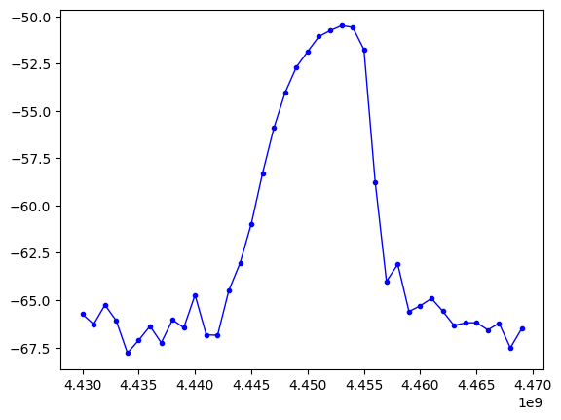
SWEEP Two tone
Vna -5dBm
inst_att.set_attenuation(50)
inst_RFsourceExcitation.set_amplitude(15)
Freq = np.arange(4430, 4470, 3) * 1e6
Filtro DC-5000, filtro 3500-4500, DC block, att10dB, att20dB

Slide 8
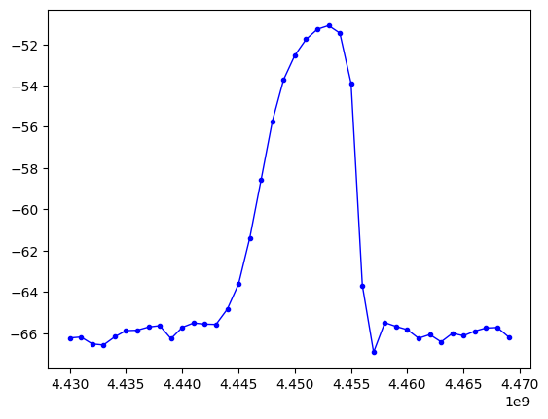
SWEEP Two tone
Vna -5dBm
inst_att.set_attenuation(50)
inst_RFsourceExcitation.set_amplitude(8)
Freq = np.arange(4430, 4470, 3) * 1e6
Filtro DC-5000, filtro 3500-4500, DC block, att10dB, att20dB

Slide 9
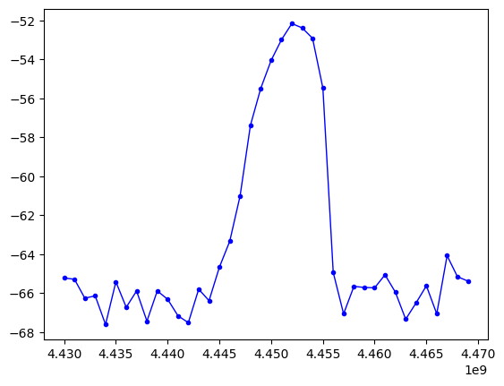
SWEEP Two tone
Vna -5dBm
inst_att.set_attenuation(50)
inst_RFsourceExcitation.set_amplitude(4)
Freq = np.arange(4430, 4470, 3) * 1e6
Filtro DC-5000, filtro 3500-4500, DC block, att10dB, att20dB

Slide 10
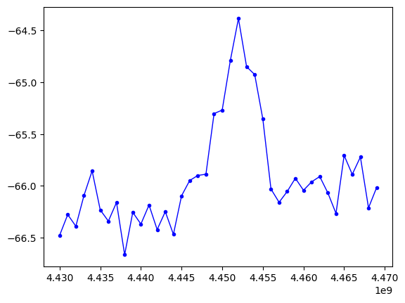
SWEEP Two tone
Vna -5dBm
inst_att.set_attenuation(50)
inst_RFsourceExcitation.set_amplitude(-15)
Freq = np.arange(4430, 4470, 3) * 1e6
Filtro DC-5000, filtro 3500-4500, DC block, att10dB, att20dB

Slide 11
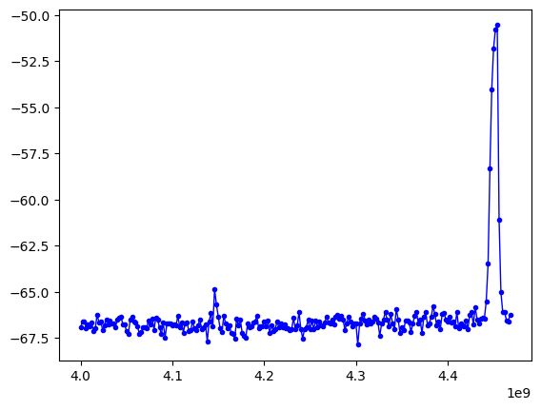
SWEEP Two tone
Vna -5dBm
inst_att.set_attenuation(50)
inst_RFsourceExcitation.set_amplitude(-15)
Freq = np.arange(4000, 4470, 3) * 1e6
Filtro DC-5000, filtro 3500-4500, DC block, att10dB, att20dB
TWOTONE_SWEEP_Q2TII__2024_10_03__12_18_42

Slide 12
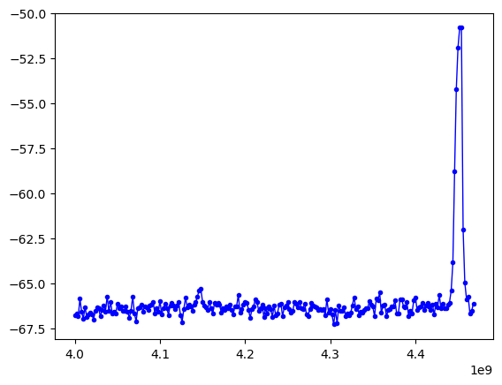
SWEEP Two tone
Vna -5dBm
inst_att.set_attenuation(50)
inst_RFsourceExcitation.set_amplitude(-10)
Freq = np.arange(4000, 4470, 3) * 1e6
Filtro DC-5000, filtro 3500-4500, DC block, att10dB, [[[]]]
TWOTONE_SWEEP_Q2TII__2024_10_03__12_18_42

Slide 13
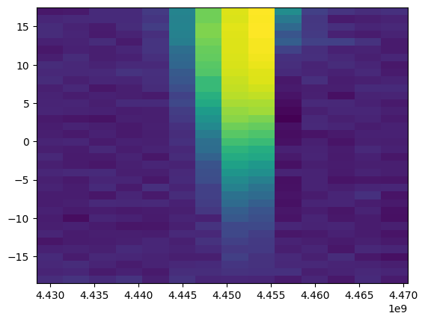
Map Two tone
Vna -5dBm
inst_att.set_attenuation(50)
Amp = np.arange(-18, 18, 1)
Freq = np.arange(4430, 4470, 3) * 1e6
Filtro DC-5000, filtro 3500-4500, DC block, att10dB, att20dB
TWOTONE_MAP_Q2TII_2024_10_03__10_43_43.npz

Slide 14
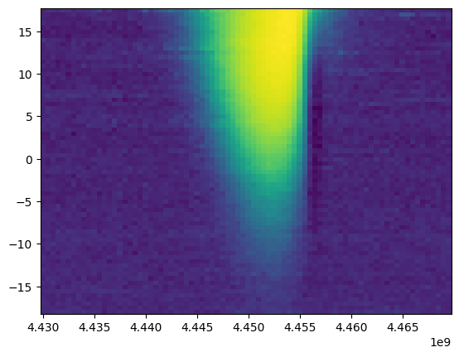
Map Two tone
Vna -5dBm
inst_att.set_attenuation(50)
Amp = np.arange(-18, 18, 0.5)
Freq = np.arange(4430, 4470, 0.5) * 1e6
Filtro DC-5000, filtro 3500-4500, DC block, att10dB, att20dB
TWOTONE_MAP_Q2TII_2024_10_03__10_56_49

Slide 15
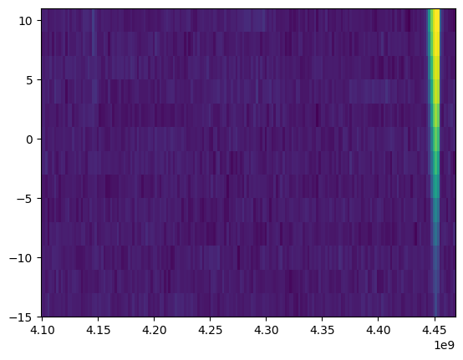
Map Two tone
Vna -5dBm
inst_att.set_attenuation(50)
Amp = np.arange(-14, 12, 2)
Freq = np.arange(4100, 4470, 0.5) * 1e6
Filtro DC-5000, filtro 3500-4500, DC block, att10dB, att20dB
TWOTONE_MAP_Q2TII_2024_10_03__12_26_56

Slide 16
Pulsado

Slide 17
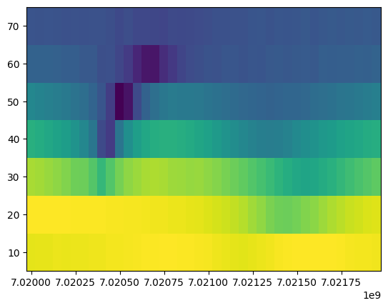

Slide 18
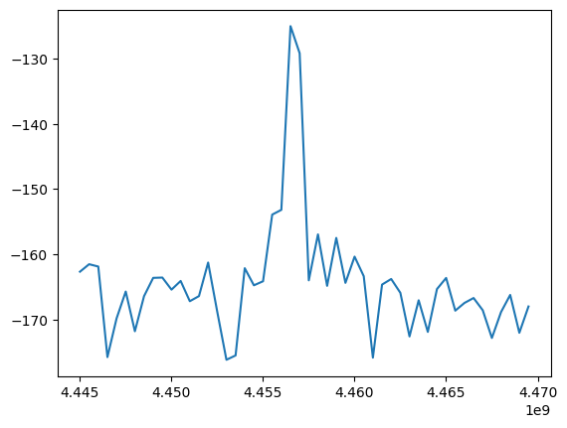
TWOTONE_2QTII_ExctQubit_2024_10_03__15_30_33
inst_att.set_attenuation(50)
inst_RFsourceMeasurement.set_frequency(7.02050e9-240e6)
inst_RFsourceMeasurement.set_amplitude(18)
inst_RFsourceExcitation.set_amplitude(11)
freqs = np.arange(4445,4470,0.5)*1e6
p1 = SquarePulse(length = 1e-6, amplitude = 0.1) # I

Slide 19
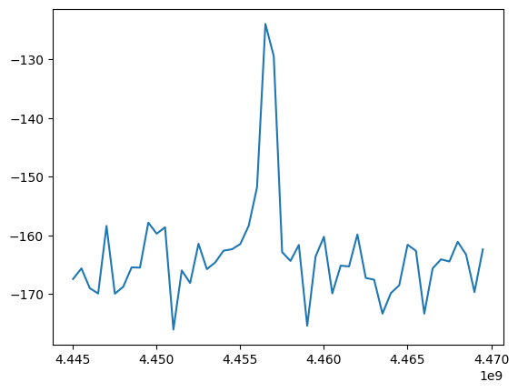
TWOTONE_2QTII_ExctQubit_2024_10_03__15_34_16.npz
inst_att.set_attenuation(50)
inst_RFsourceMeasurement.set_frequency(7.02050e9-240e6)
inst_RFsourceMeasurement.set_amplitude(18)
inst_RFsourceExcitation.set_amplitude(11)
freqs = np.arange(4445,4470,0.5)*1e6
p1 = SquarePulse(length = 1e-6, amplitude = 0.08) # I
fmax=4456500000

Slide 20
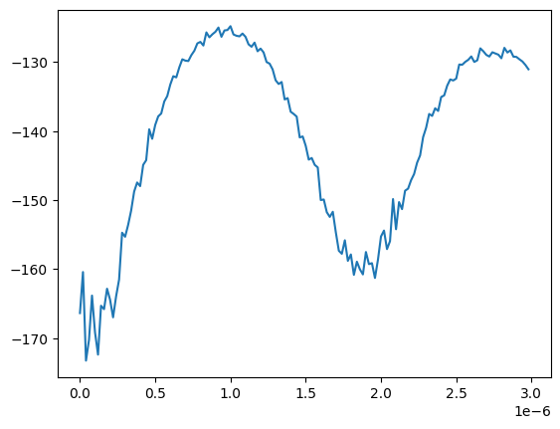
RABI_2QTII_ExctQubit_2024_10_03__15_48_30
alazar_params['recordsPerBuffer'] = 250
alazar_params['buffersPerAcquisition'] = 100
inst_att.set_attenuation(50)
inst_RFsourceMeasurement.set_frequency(7.02050e9-240e6)
inst_RFsourceExcitation.set_frequency(4.456500000e9)
inst_RFsourceMeasurement.set_amplitude(18)
inst_RFsourceExcitation.set_amplitude(11)
durations = np.arange(0,3000e-9,20e-9)
p1 = SquarePulse(length = 0, amplitude = 0.08)
pi_pulse=0.97e-6 s

Slide 21
Pulsado com AWG direto on qubit
Exc qubit = Filtro DC-5000, filtro 3500-4500, DC block, att10dB
Measurement_Q2_Daniel_pulsado switch.ipynb

Slide 22
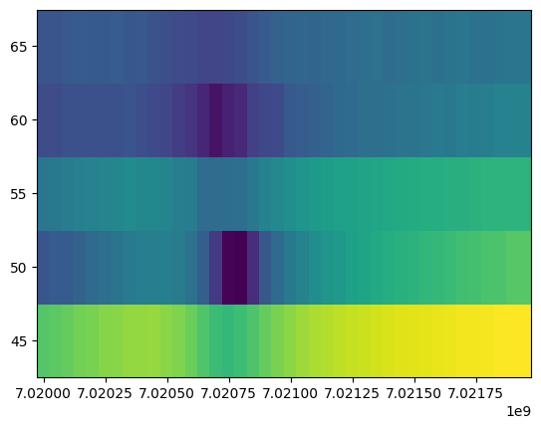
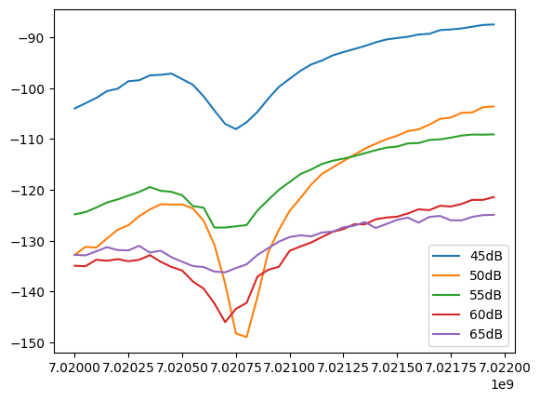
PowerSweep_2QTII__2024_10_04__15_59_17
Min 50dB=7.0208GHz

Slide 23
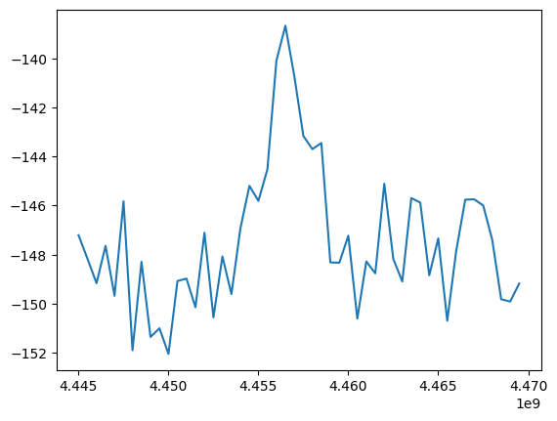
TWOTONE_2QTII_ExctQubit_2024_10_04__16_21_28
inst_att.set_attenuation(50)
inst_RfsourceMeasurement.set_frequency(7.02080e9-240e6)
p1 = GaussianCosPulse(length = 10e-6, frequency = freq, amplitude = 0.4,sigma=1.5e-6)
Freqmax=4.4565GHz

Slide 24
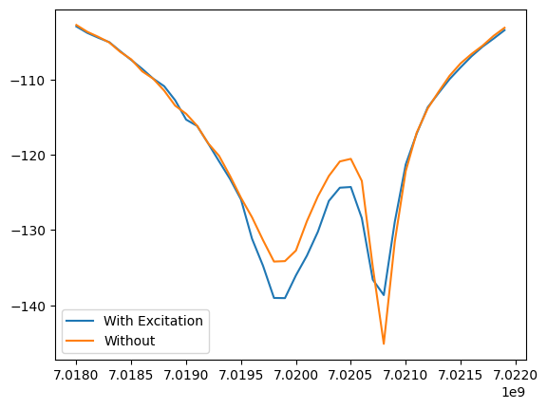
Two tone with and without qubit excitation
TWOTONE_2QTII_ExctQubit_2024_10_04__16_28_39 With
p1 = GaussianCosPulse(length = 10e-6, frequency =4456500000 , amplitude = 0.4,sigma=1.5e-6)
TWOTONE_2QTII_ExctQubit_2024_10_04__16_39_44 Without
p1 = ZeroPulse(length=0)

Slide 25
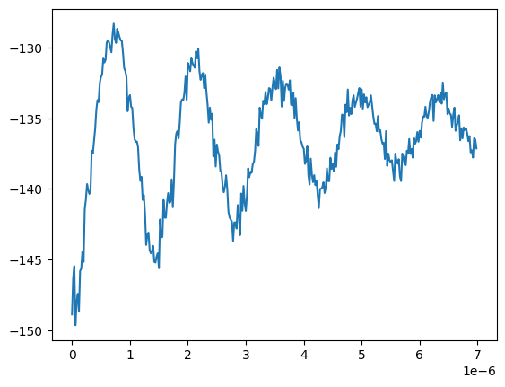
RABI_2QTII_ExctQubit_2024_10_04__17_08_26
pi_pulse=7.0633001e-07s (sigma gaussian =0.15*pi_pulse)
p1 = GaussianCosPulse(length = 0, frequency =4.4565e9 , amplitude = 0.4,sigma=0)
inst_att.set_attenuation(50)
Each loop:
p1.length = duration
p1.sigma=0.15*duration

Slide 26
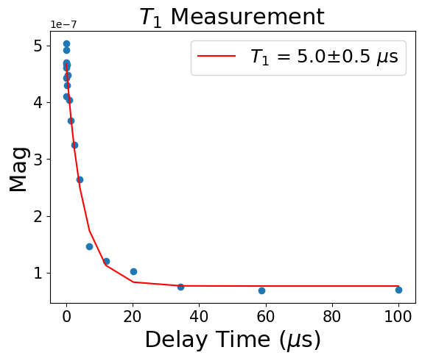
T1_2QTII__2024_10_04__18_39_34

Slide 27
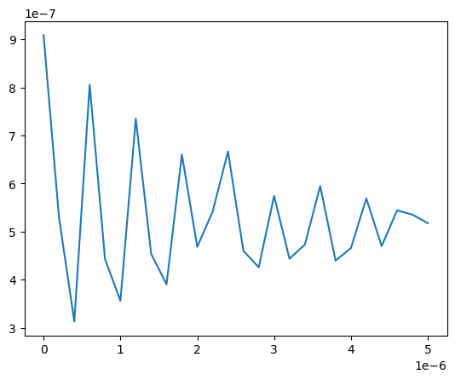
T2_3QTII__2024_08_30__16_30_50
p1=gcp.Gaussian2( amplitude = 0.4,frequency=4.4565e9,T=0,sigma=0.15*PiPulse/2)
PiPulse = 7.0633001e-07
inst_RfsourceMeasurement.set_frequency(7.0208e9-240e6)
Obs:Detuning=+100MHz no oscillation

Slide 28
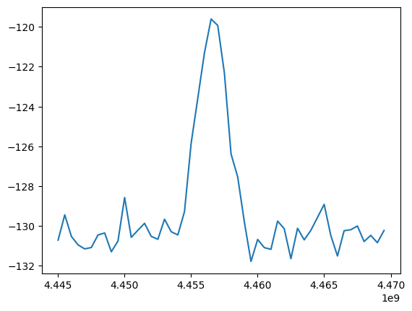
TWOTONE_2QTII_ExctQubit_2024_10_04__22_04_56
length=7.0633001e-07
p1 = GaussianCosPulse(length = length, frequency = freq, amplitude = 0.4,sigma=0.15*length)
Fqubit=4.4565GHz

Slide 29
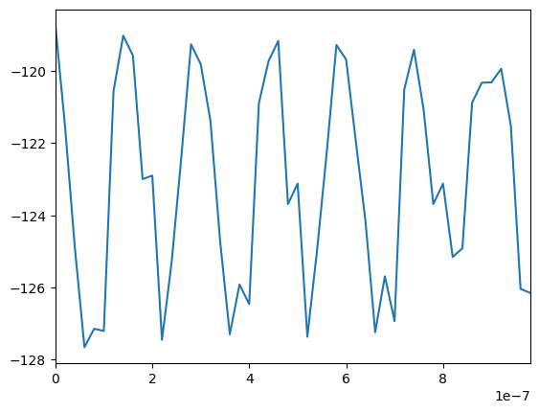
T2_2QTII__2024_10_04__22_24_04
p1=gcp.Gaussian2( amplitude = 0.4,frequency=4.4565e9+Detuning,T=0,sigma=0.15*PiPulse/2)
PiPulse = 7.0633001e-07
inst_RfsourceMeasurement.set_frequency(7.0208e9-240e6)
Obs:Detuning=+0.1MHz

Slide 30
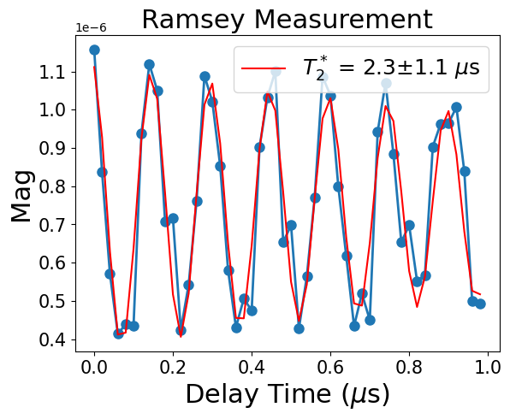
FIT T2_2QTII__2024_10_04__22_24_04

Slide 31
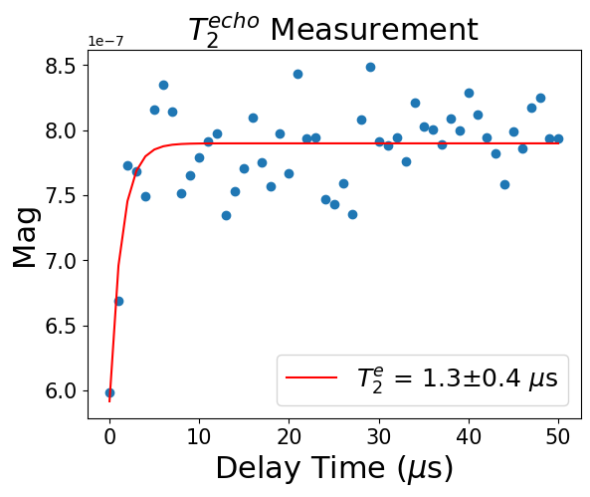
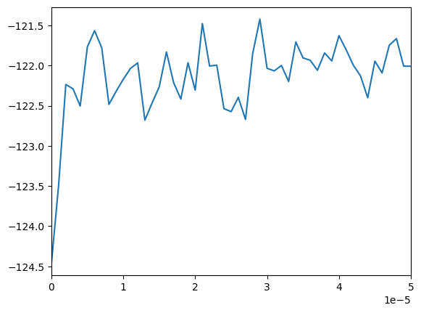
T2e_2QTII__2024_10_04__22_57_32

Slide 32
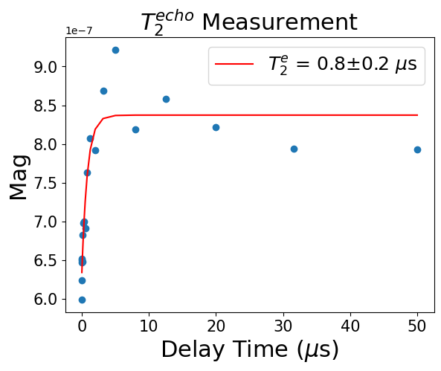
T2e_2QTII__2024_10_04__23_20_14

Slide 33
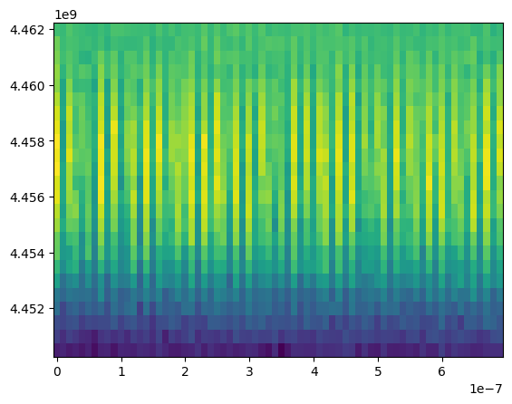
ChevronRamsey_2QTII__2024_10_05__00_37_09.npz

Slide 34
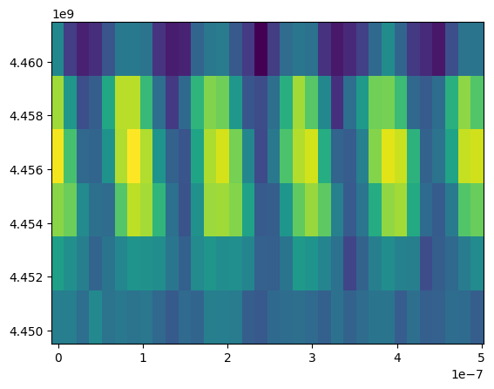
ChevronRamsey_2QTII__2024_10_05__11_47_20

Slide 35
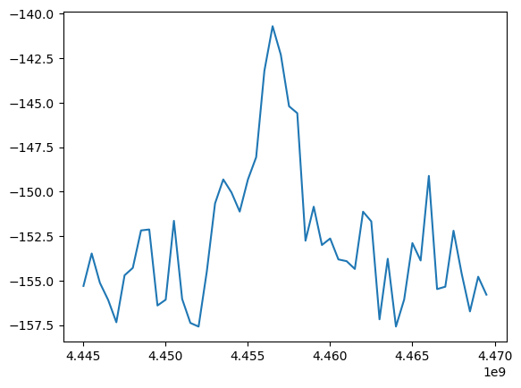
TWOTONE_2QTII_ExctQubit_2024_10_05__17_02_19

Slide 36
Pulso quadrado (com borda gaussiana)

Slide 37
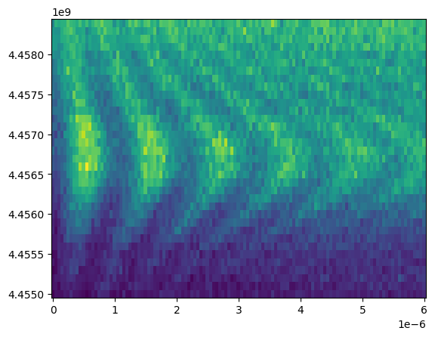
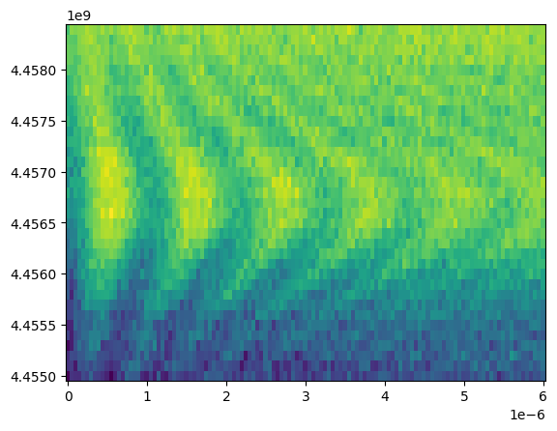
ChevronRabi_2QTII__2024_10_05__19_47_08

